Slide 1
UNIFIED MENTOR
INTERSHIP

Slide 2
Project 1
Budget Sales Analytics

Slide 3
INTORDUCTION
The collection includes records for sales orders, customer information, product information, and geographical data.
In order to deduce important metrics and patterns in the dataset, this project will use the provided data to perform ETL and data analysis.
Additionally, several visualizations and reports are created to represent significant linkages.

Slide 4
OBJECTIVES & BENEFITS
OBJECTIVE
The collection includes records for sales orders, customer information, product information, and geographical data.
In order to deduce important metrics and patterns in the dataset, this project will use the provided data to perform ETL and data analysis.
Additionally, several visualizations and reports are created to represent significant linkages.
BENEFITS
Help in making wiser business decisions.
Aid in customer satisfaction and trend monitoring, which can serve current consumers and attract new ones.
Greater client base understanding is provided.
Facilitates seamless resource management flow

Slide 5
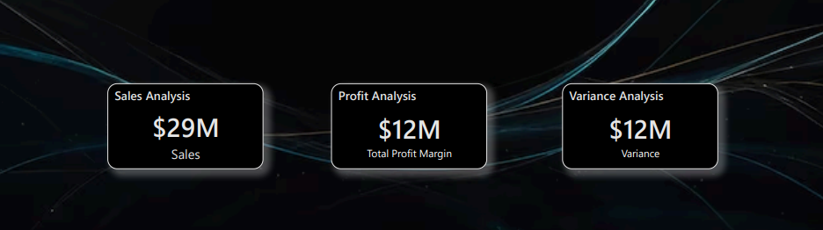
KPIs

Slide 6
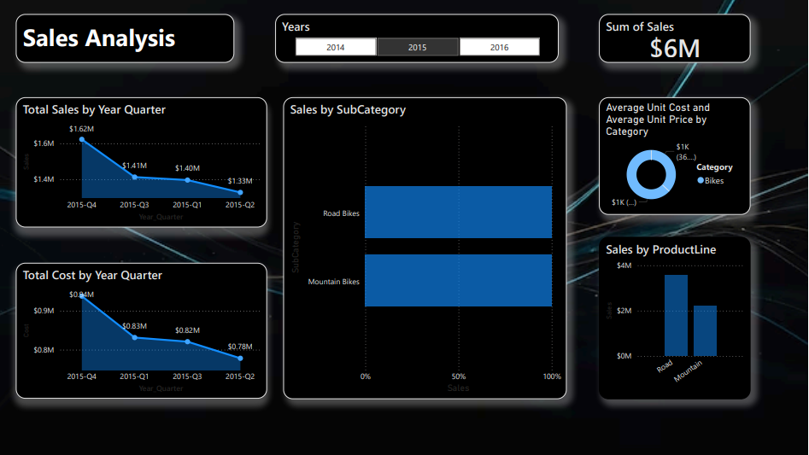
MY DESIGN

Slide 7
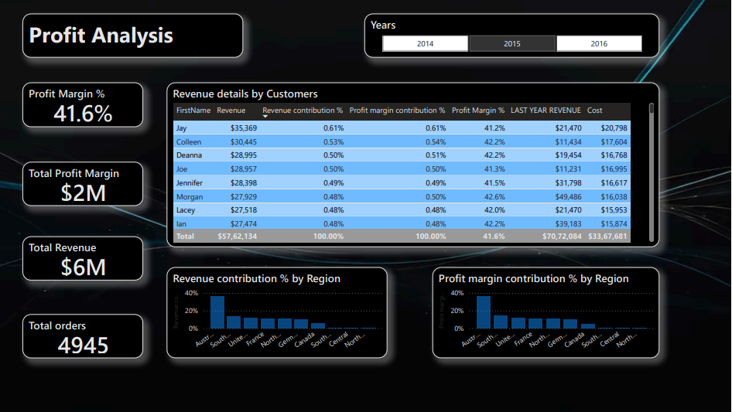

Slide 8
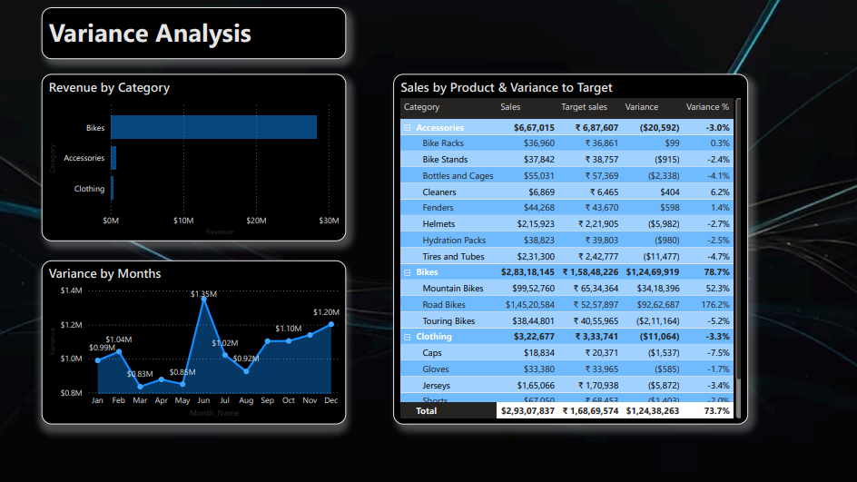

Slide 9
CONCLUSION
High quantity of products is ordered from Australia and United States.
Major Profit is contributed by the Bike Category.
Maximum profit earned in the months of June, November, and December.
High sales orders are seen on Wednesday and Saturday, when compared to other weekdays.
There is a high negative correlation between Price and number of Quantity ordered.
High salary range leads to increase in revenue.

Slide 10
Project 2
Analyzing Amazon Sales data

Slide 11
INTORDUCTION
Amazon Sales data refers to sales, high performing sellers and several other data points.
There are millions of Amazon sellers around the world. Amazon sales data Analysis focuses on the process of analyzing consumer behavior, sales, and several other attributes in order to make improved, data-driven decisions.
It is key to successfully sustaining their businesses and earning profits and for this purpose, they analyze different metrics like Total Sales, Sales Quantity, Total Profit, Sales, Last Year Sales and other metrics.
By analyzing these different metrics, we will be able to increase and improve our performance.

Slide 12
OBJECTIVES & BENEFITS
OBJECTIVES
Sales management has gained importance to meet increasing competition and the need for improved methods of distribution to reduce cost and to increase profits.
Sales management today is the most important function in a commercial and business enterprise
BENEFITS
Help out to make better business decisions.
Help analyze customer trends and satisfaction, which can lead to new and better products and services.
Gives better insight of customers base.
Helps in easy flow for managing resources.

Slide 13
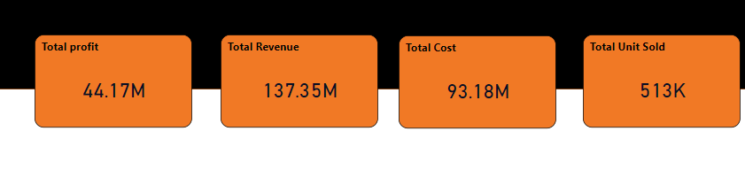
KPIs

Slide 14
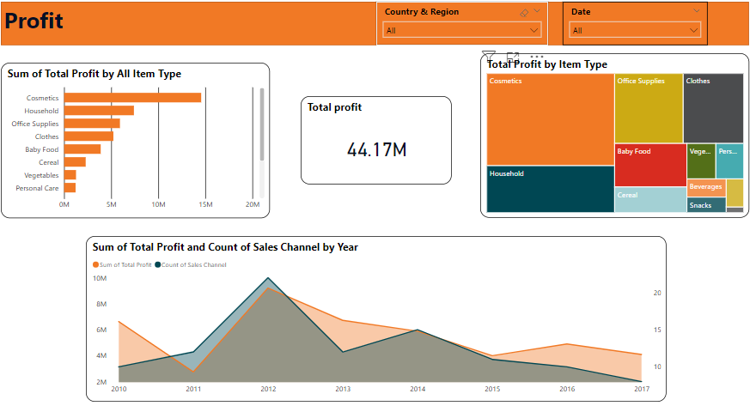

Slide 15
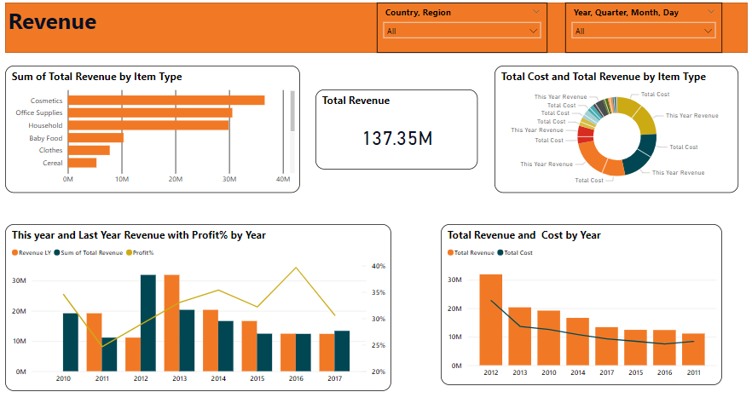

Slide 16
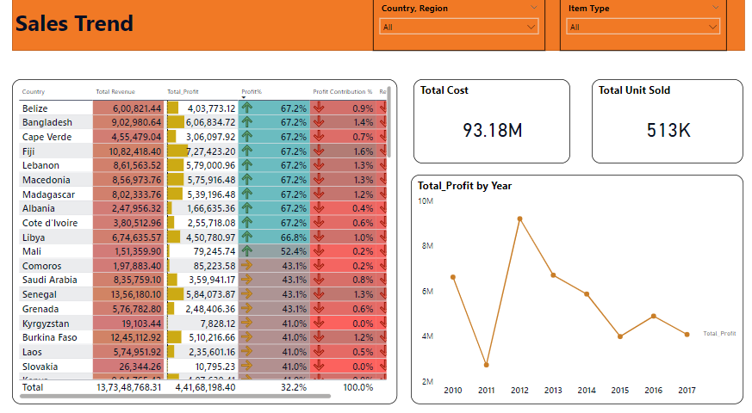

Slide 17
CONCLUSION
If we observe the monthly insights of 2017,2018,2019, the sales are at their peak in March, June, and September and are low in April, May & October. Amazon can come up with some good discounts and offers to generate high revenue.
The sales for the US are highest among all countries and lowest in Iran (IR).
The Better Large Canned Shrimp & High Top Dried Mushrooms are the highest selling products in domestic and international markets.

Slide 18
THANK YOU

